Slide 1

Seismic signals at the Soufriere Hills Volcano
Talk given to EU Training Network students, May 2002 by Glenn Thompson, MVO Seismologist

Slide 2
1 Benefits of seismic monitoring
24 hours a day – not affected by night (e.g. spectroscopy) or clouds (visual obs)
Different volcanic processes generate characteristic seismic signals
Alarm systems to alert scientists immediately of escalation in volcanic activity
Gives the most direct information about what is happening inside the volcano now
Equipment is cheap and low maintenance
The most effective method of monitoring volcanic activity

Slide 3
2 Basic event types
Notes:
Photos of station, diagrams of how telemetry works

Slide 4

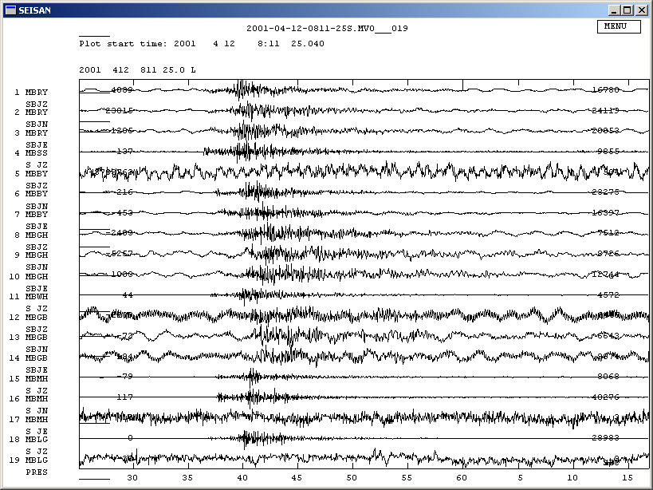
Volcano-tectonic
S – P < 2 s, energy > 5 Hz, usually occur in swarms

Slide 5
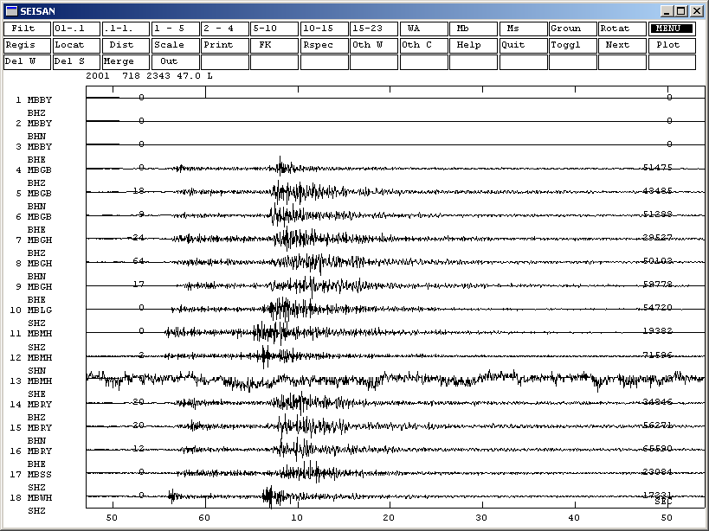
Regional
S-P > 3 s

Slide 6
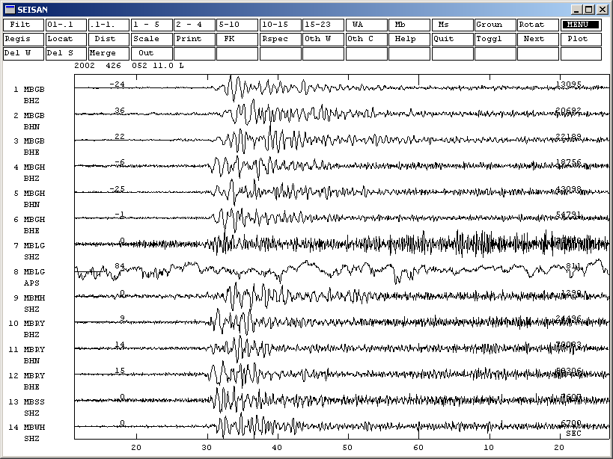
Long-period
Phaseless, 1 – 2.5 Hz

Slide 7
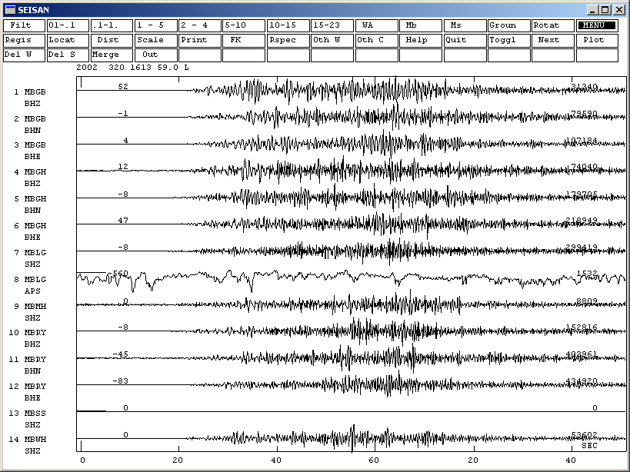
rockfall
Phaseless, emergent, broadband, coincide with rockfalls from dome

Slide 8
3 Mixed event types
Notes:
Photos of station, diagrams of how telemetry works

Slide 9
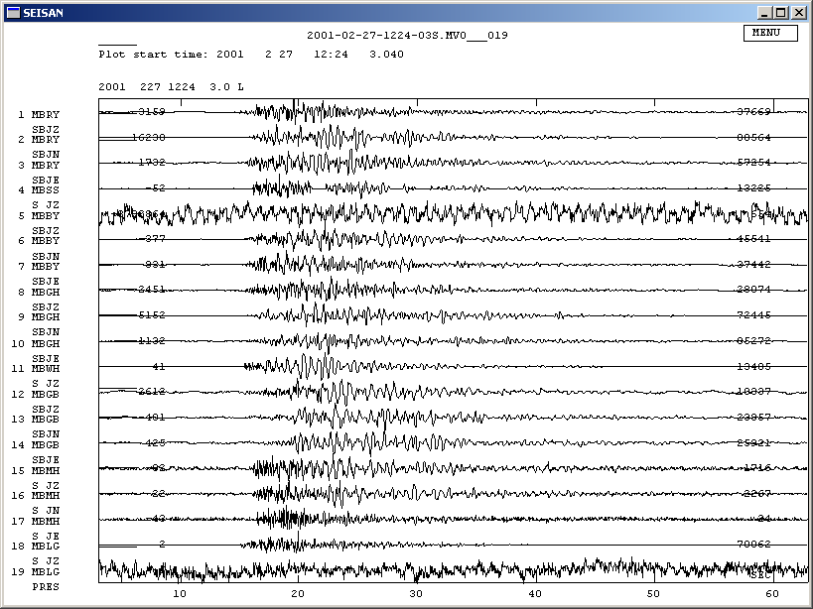
hybrid
P wave, high frequency onset, long-period coda, usually occur in swarms

Slide 10
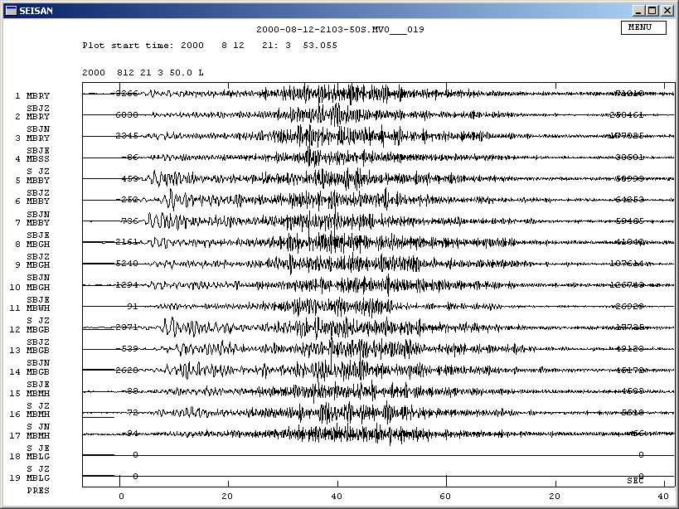
Long-period rockfall
Long-period earthquake, followed by rockfall

Slide 11
Dominant event types (Oct 96 – Apr 02)
 | VT | HYBRID | LP | LP-RF | RF
Total # | 5552 | 38238 | 10078 | 5972 | 76137
Cumulative magnitude | 4.0 | 5.0 | 3.5 | 3.7 | 4.4

Slide 12
4 Continuous signals
(anything the event triggering algorithm wont detect)
Notes:
Photos of station, diagrams of how telemetry works

Slide 13
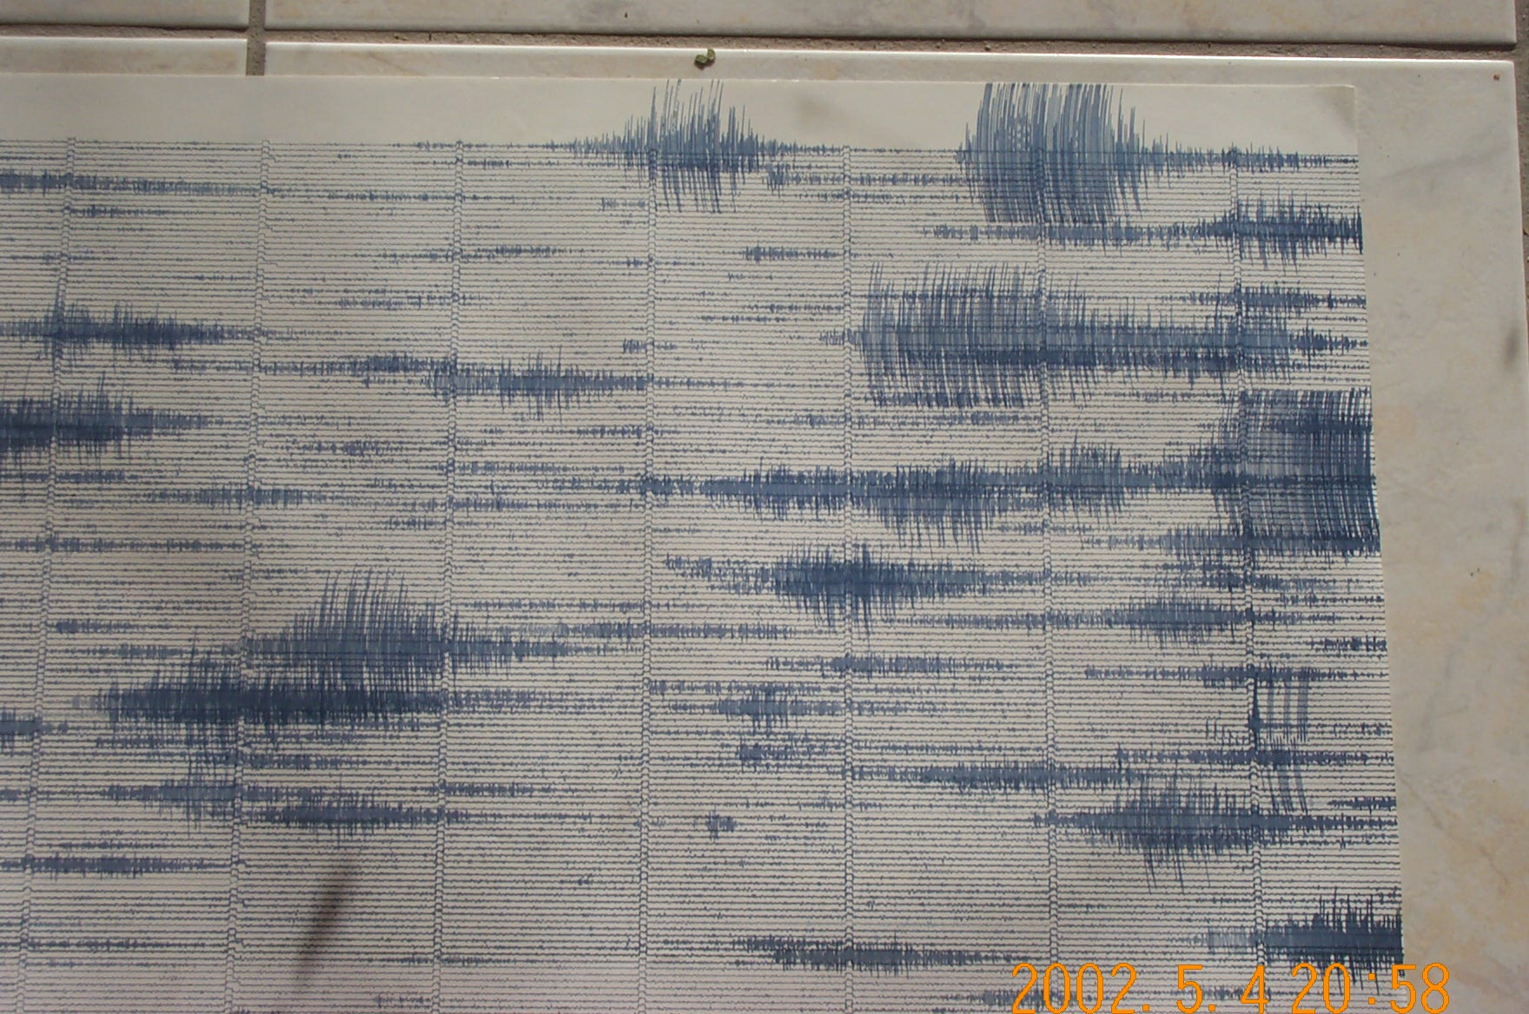
Normal day 2000-2002 - rockfalls

Slide 14
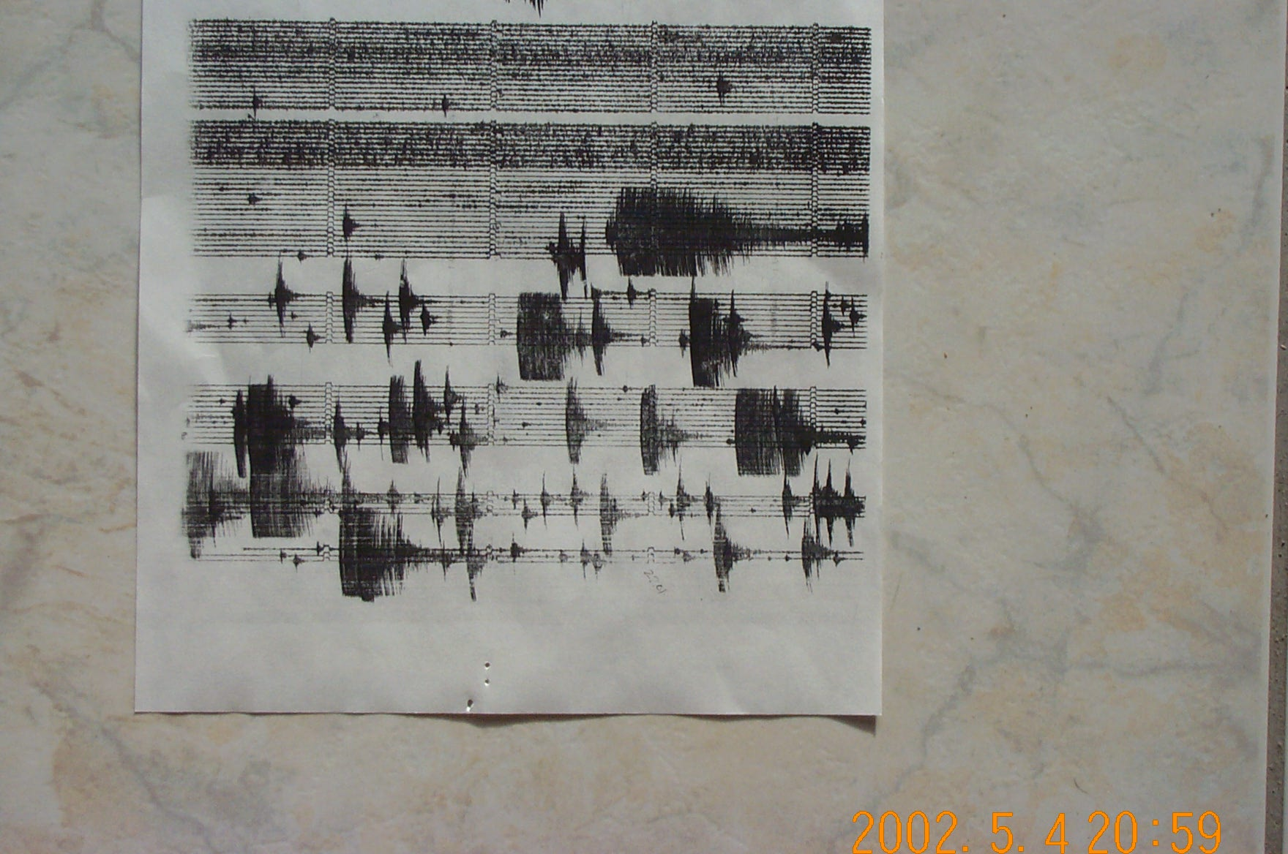
VT swarm - 1995

Slide 15
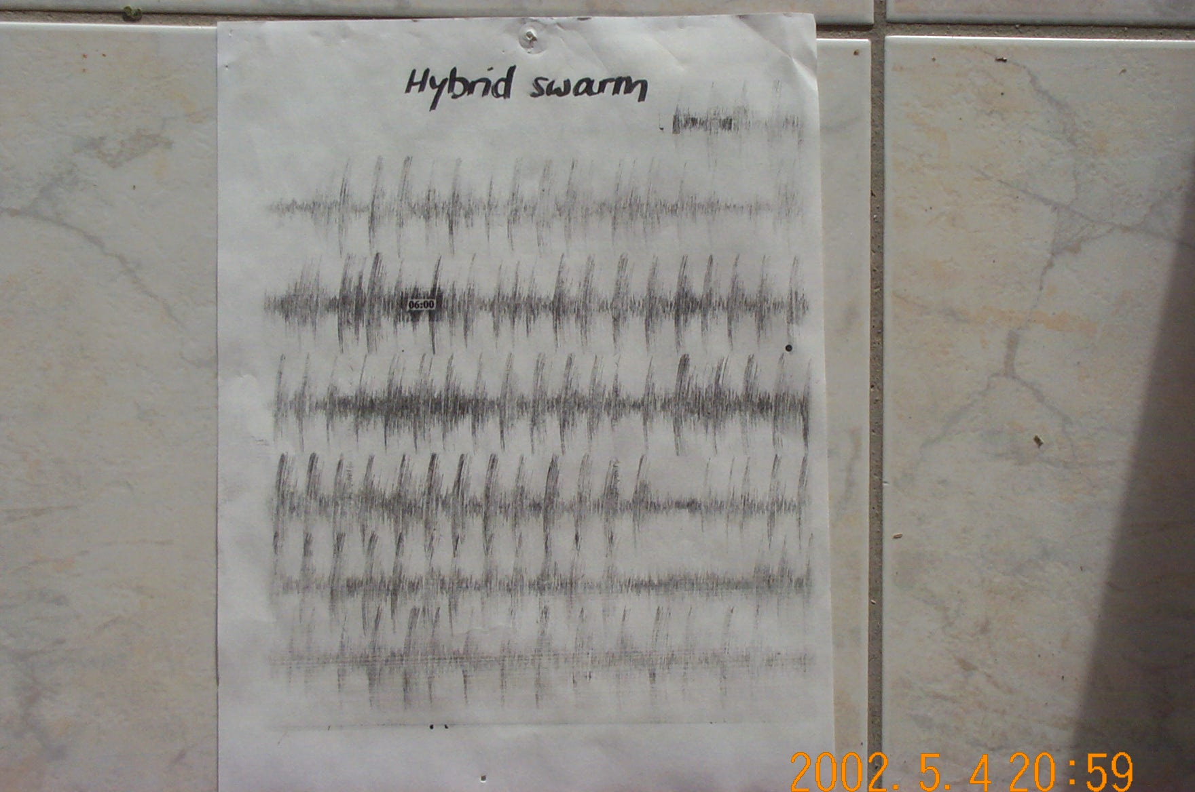
Hybrid swarm - 1997

Slide 16
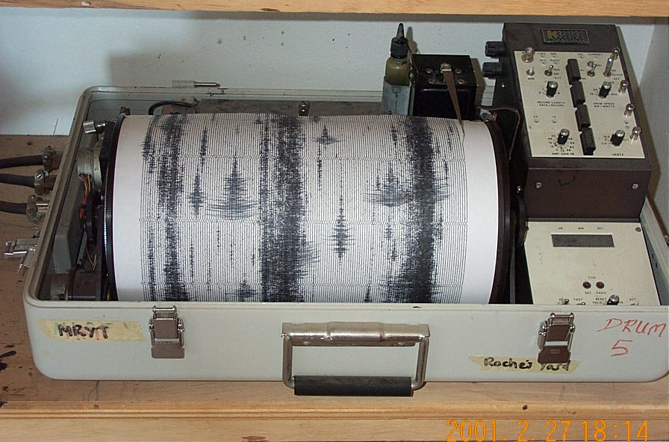
Banded tremor

Slide 17
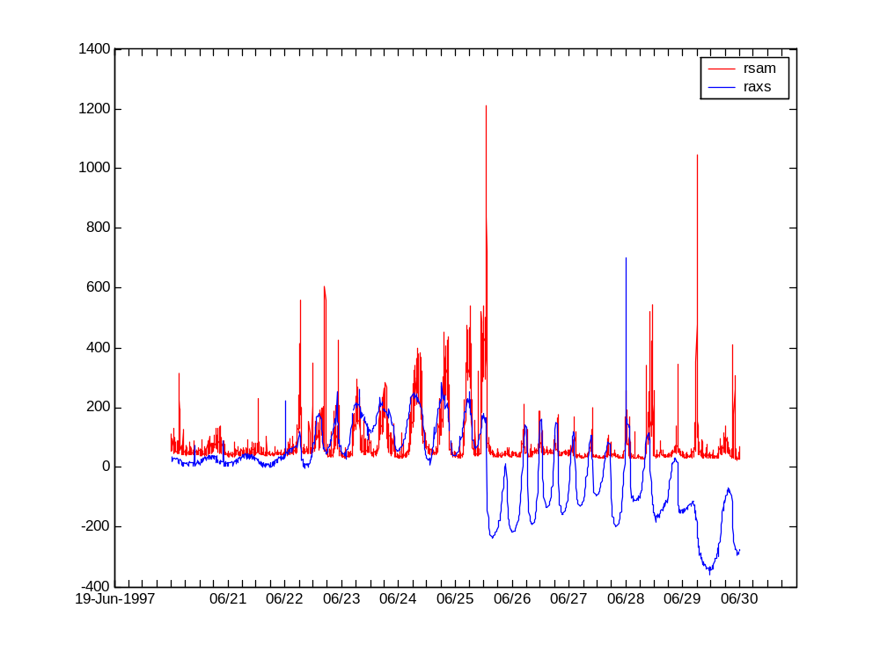
Tremor cycles vs. tilt

Slide 18
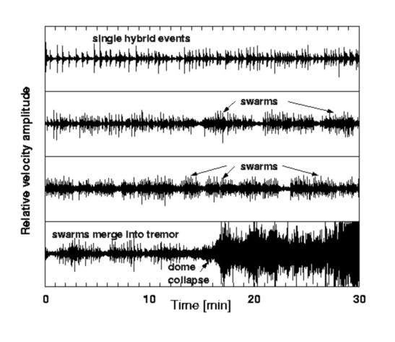
resonator
Nucleation
level
Resonant frequency depends on:
nucleation level
bubble density
-> gas content & pressure

Slide 19
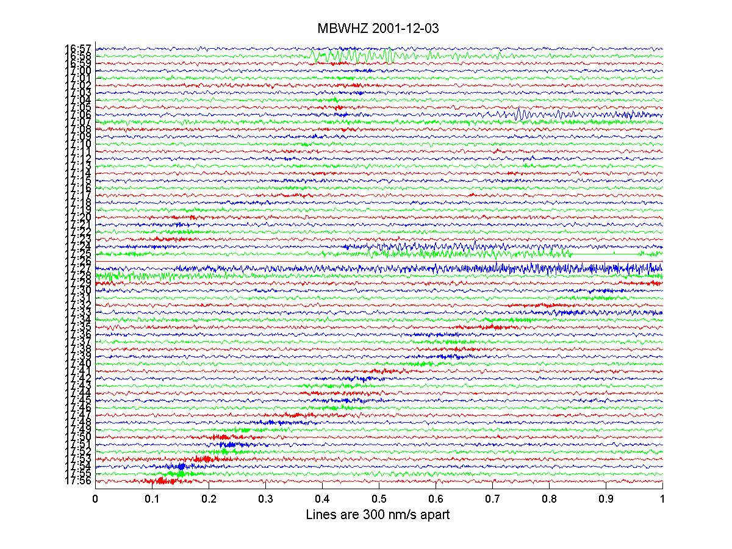
Swarm –resting pulse

Slide 20
Swarm – intensifying

Slide 21
Tremor – gliding lines?

Slide 22
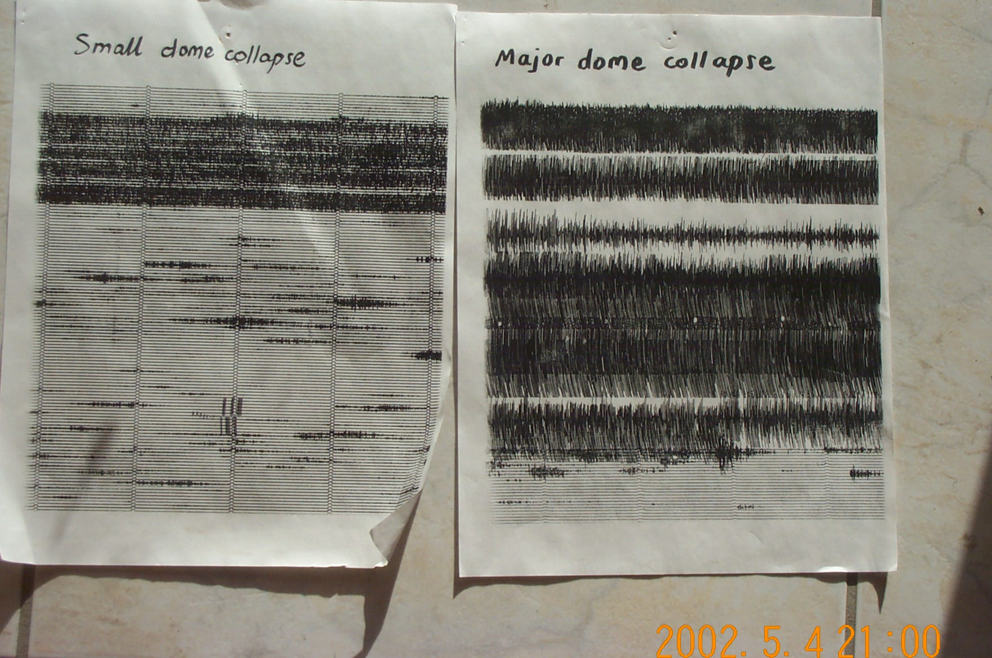

Slide 23
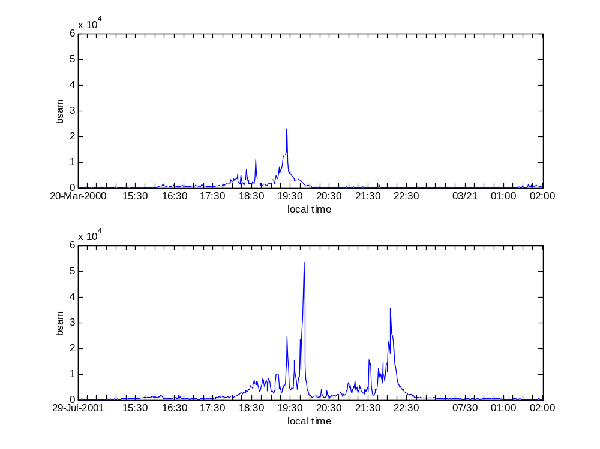
Dome collapse
20 March 2000
29 July 2001

Slide 24
5 Patterns to look out for
Notes:
Photos of station, diagrams of how telemetry works

Slide 25
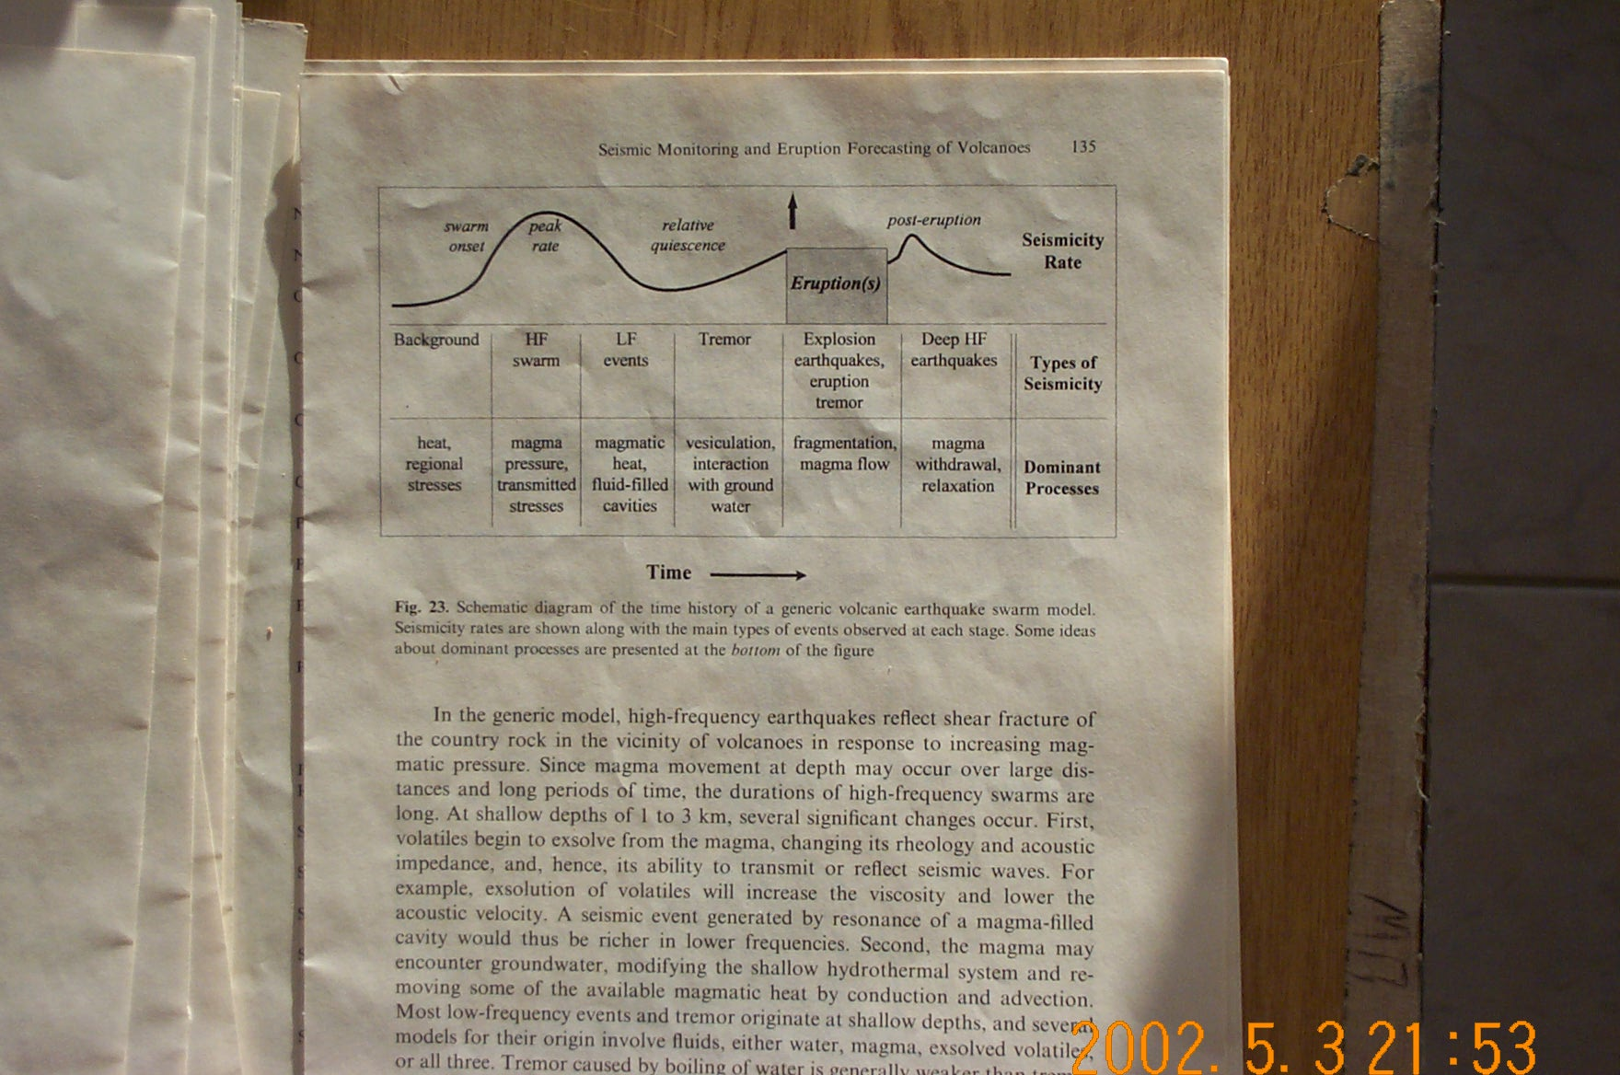
Generic volcanic earthquake swarm model, McNutt 1996

Slide 26
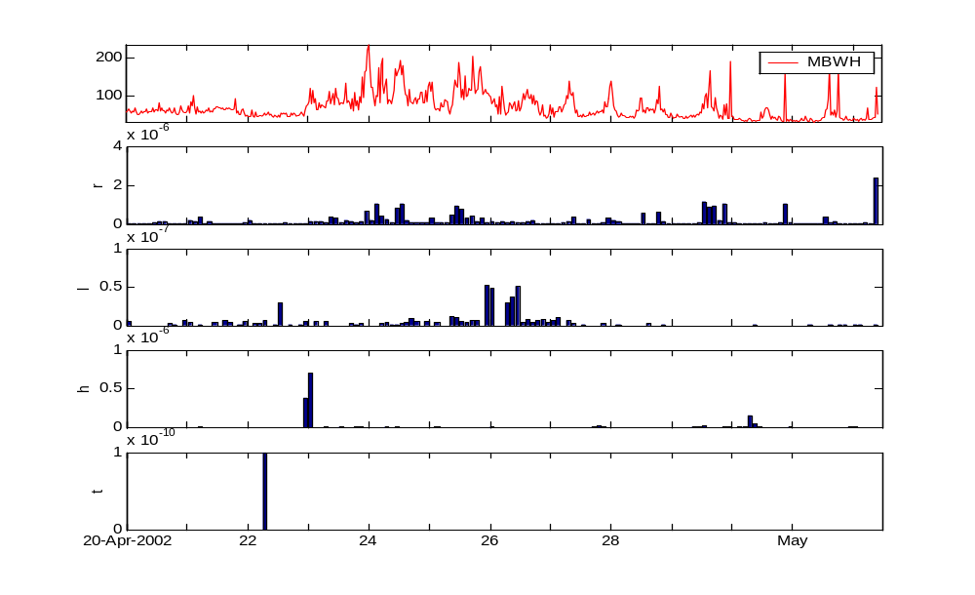
Vt swarm (migration of hypocenters)
Non-cyclic hybrid swarm
Increased rockfall activity
Long-period events
Tremor, tilt & rockfall cycles
Explosions / Dome collapses
BSAM
rf
lp
hybrid
vt

Slide 27
5 Towards a better understanding
Notes:
Photos of station, diagrams of how telemetry works

Slide 28

Comparison of seismic & DOAS data
What is the phase relationship between banded tremor and SO₂?
Are long-period earthquakes caused by gas release?
Do rockfalls release stored up SO₂?
Is there any correlation between hybrids and SO₂?

Slide 29
Other signals which sound like tremor 1
Mystery 1

Slide 30
Other signals which sound like tremor 2
Mystery 2

